Slide 1
Intro to R Shiny
R Ladies
Feb 12th, 2020
Angelique Zeringue
Borrowed heavily from Garrett Grolemund’s ‘How to Start with Shiny’

Slide 2
Today’s Agenda
How Shiny works and how to build an app
Demo (walking you through how the Metric 8 Ball app was created)
Time permitting: You try building a simple app

Slide 3
The Basics

Slide 4
R Shiny
Functionality in R that allows building interactive web apps
Apps can be hosted locally or publicly
Used for
Entertainment value
Dashboards
Data visualization
Sharing information
See https://shiny.rstudio.com/gallery/ to view examples

Slide 5
Shiny app example
Interactive web app
Users can choose options or add input
This results in output, like a graph

Slide 6

Requirements
R with R Studio
Web browser
Internet access
R packages
shiny
shinythemes
rsconnect

Slide 7
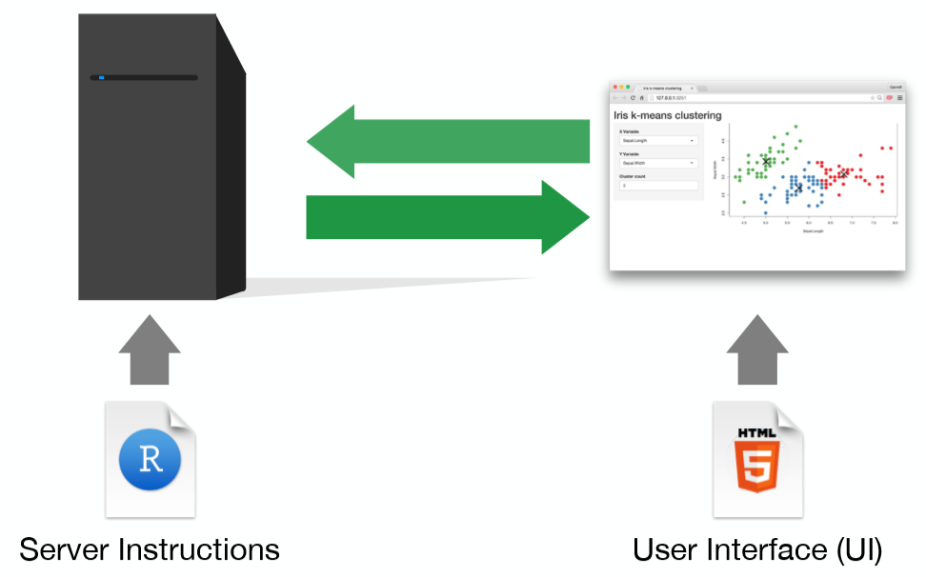
architecture
Behind every Shiny app is a computer actively running it in R
Shiny can be hosted
On your laptop, but only you see it
On a Linux server, but only those with access see it
On shinyapps.io, anyone can see it
Free for the casual user, but requires an account
https://shiny.rstudio.com/tutorial/

Slide 8

Main Steps
Write a program in R
Test and debug
Convert it to Shiny app
Test and debug
Make it pretty!
Make sure it meets expectations
(optional) Host it somewhere to share it

Slide 9
Structure*
library(shiny)
# This part structures the app user interface
ui <- fluidPage(
)
# This part defines what the server runs behind the scenes
# The server takes the input and creates output
server <- function(input, output) {
}
# This just runs the app
shinyApp(ui = ui, server = server)
*You can use this as a template for building apps

Slide 10
Building the user interface (ui)

Slide 11
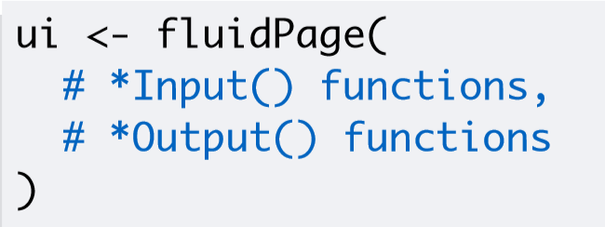
Inputs and Outputs in the UI
R Shiny is meant for interactivity
Users do something (input)
They get something back (output)
To add interactive elements to your web interface, add input and output functions to fluidPage()
fluidPage() will convert those functions into HTML and javascript so they display and function properly

Slide 12
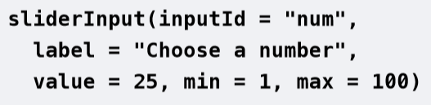
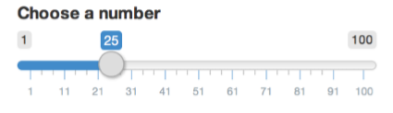
Input function example
Shiny function
Input Element Produced
HTML Created by Shiny
<div class="form-group shiny-input-container">
<label class="control-label" for="num">Choose a number</label>
<input class="js-range-slider" id="num" data-min="1" data-max="100" data-from="25" data-step="1" data-grid="true" data-grid-num="9.9" data-grid-snap="false" data-prettify-separator="," data-keyboard="true" data-keyboard-step="1.01010101010101"/>
</div>

Slide 13
Syntax
Name of the input object (needed for the server function)
Shiny function
Input Element Produced
Text that displays above or on the input object
Note: inputId not inputID

Slide 14
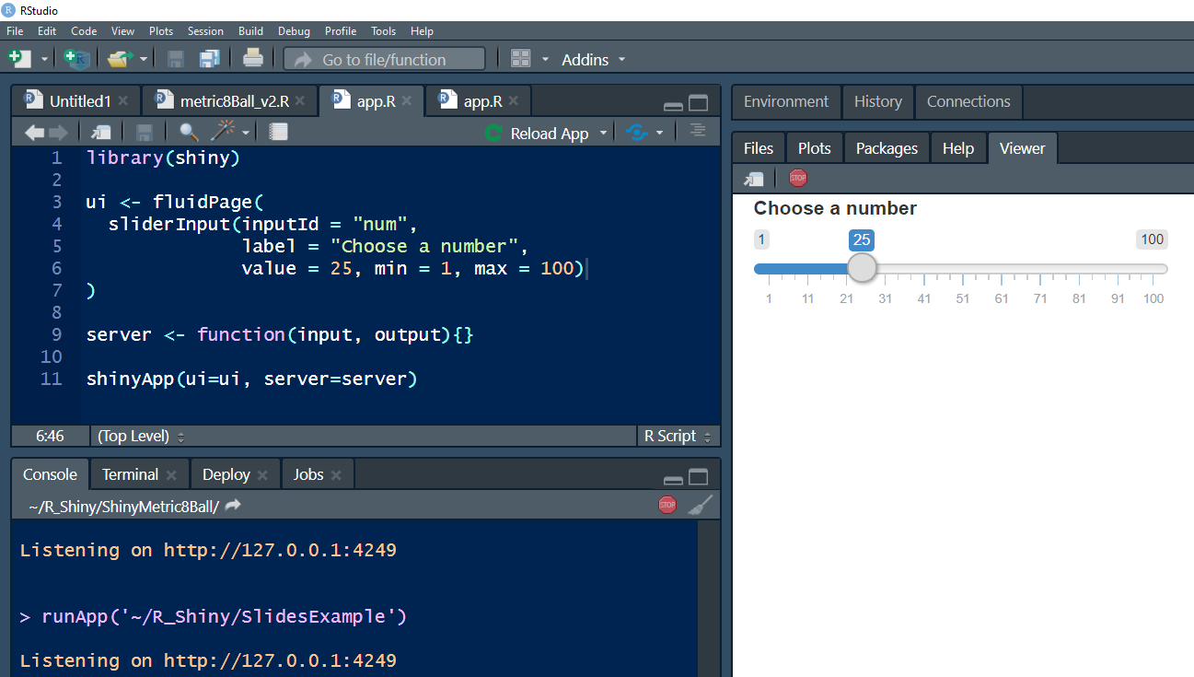

Adding input function to app
Starting from the template, you layer in the elements to produce your app
In this example, we are running the app in the viewer
You can run it in a browser, too
Must save app as app.R
Run
Stop
Run

Slide 15
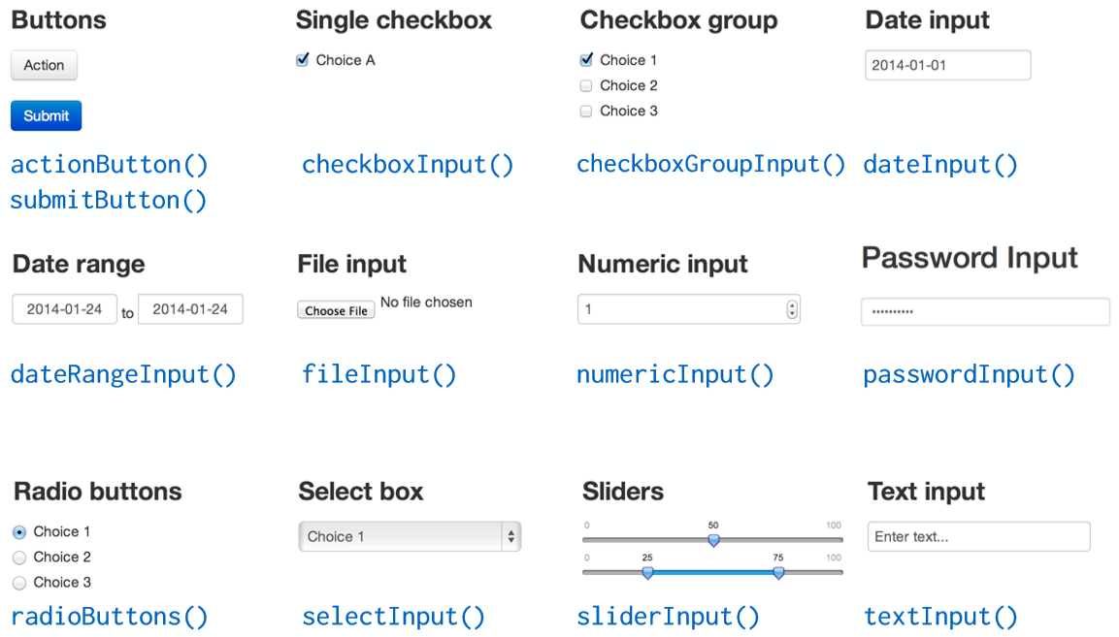
OTHER Input Options

Slide 16
Layer in output
The output code only creates space to put the output object in the UI
The server function will create the output object
Separate the various input and output objects with a comma
Name of Output Object
Type of Output

Slide 17
OUTPUT INSERT FUNCTIONS FOR THE UI
Function | Output Object Inserted into UI
dataTableOutput() | Interactive table
htmlOutput() | Raw HTML
imageOutput() | Image
plotOutput() | Plot
tableOutput() | Static table
textOutput() | Text
uiOutput() | A Shiny UI element
verbatimTextOutput() | Pre-formatted text

Slide 18
Build the server code

Slide 19
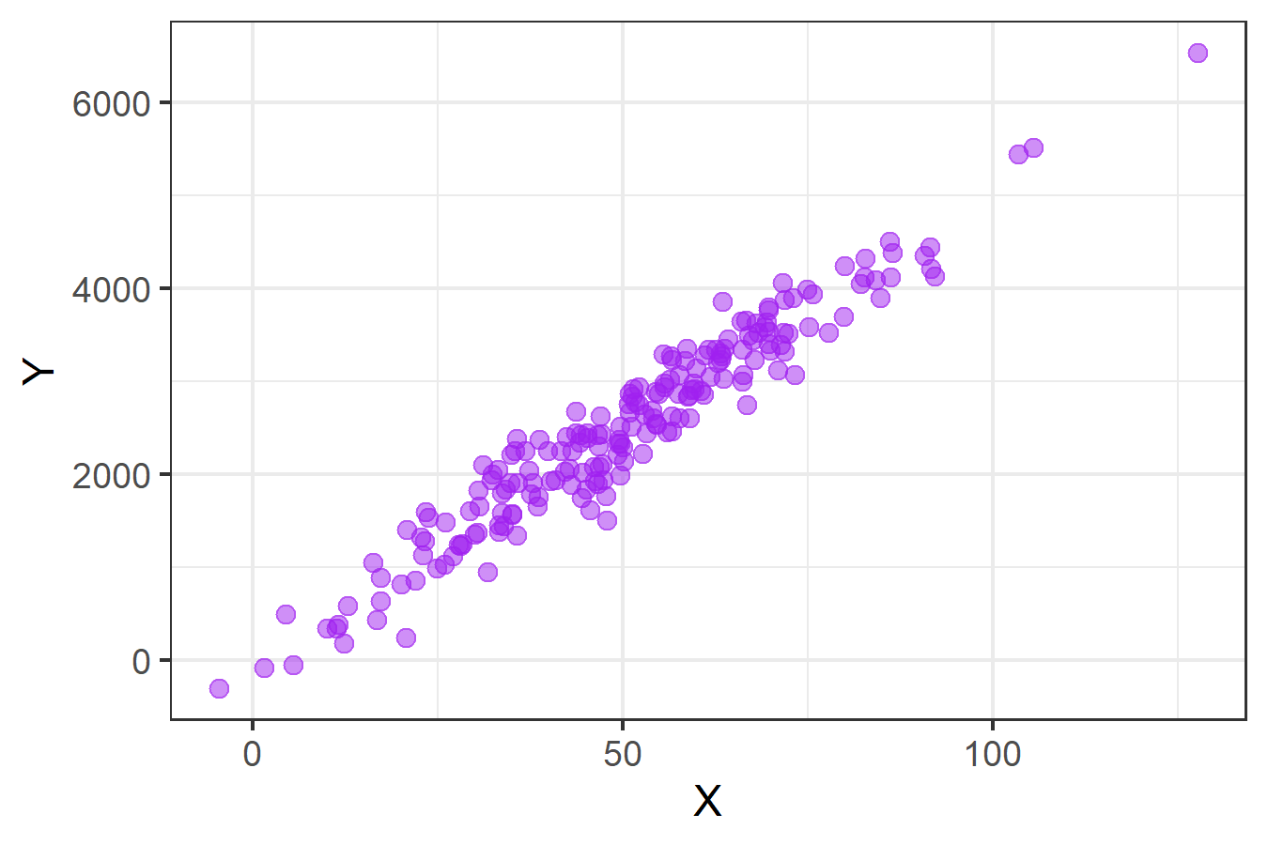
Start with R code
Want users to manipulate the beta to change scatterplot in the app

Slide 20
Add r Program to Ui Code
Cut and paste is a good way to start
The program needs modifications
Need to use the input from the UI in the program
Need to create an output object we can feed back into the UI so it displays on the app

Slide 21
Use input from Ui
Use the same inputID from the UI as the name of the input object in the server function
It must be formatted as input$<name_of_inputId>
One more change needed..
The Shiny app won’t use the input object unless it is nested in a Render function
Must be called the same thing

Slide 22
Generate output object
Again, the input object must be nested in a Render function
The render function creates the output
We need to assign it to output$<name_of_output_object> so the UI can use it

Slide 23
Generate output object
Again, the input object must be nested in a Render function
The render function creates the output
If you are creating plot output, then the Render function must also render a plot
We need to assign it to output$<name_of_output_object> so the UI can use it
Must be compatible types

Slide 24
Render functions
Function | Output Object Created
renderDataTable() | Interactive table from a data frame, matrix, or other table-like structure
renderImage() | Image (saved as link to source file)
renderPlot() | Plot
renderPrint() | Code block of printed output
renderTable() | Static table from a data frame, matrix, or other table-like structure
renderText() | Text (pre-formatted or not)
renderUI() | A Shiny UI element or HTML output

Slide 25
Generate output object
Again, the input object must be nested in a Render function
The render function creates the output
We need to assign it to output$<name_of_output_object> so the UI can use it
Must be called the same thing

Slide 26
Basic App Created!
Moving the slider modifies the graph
This is called reactivity
Occurs automatically when using input object to create output object
Depending on the type of input, reactivity can be more complicated

Slide 27
reactivity

Slide 28


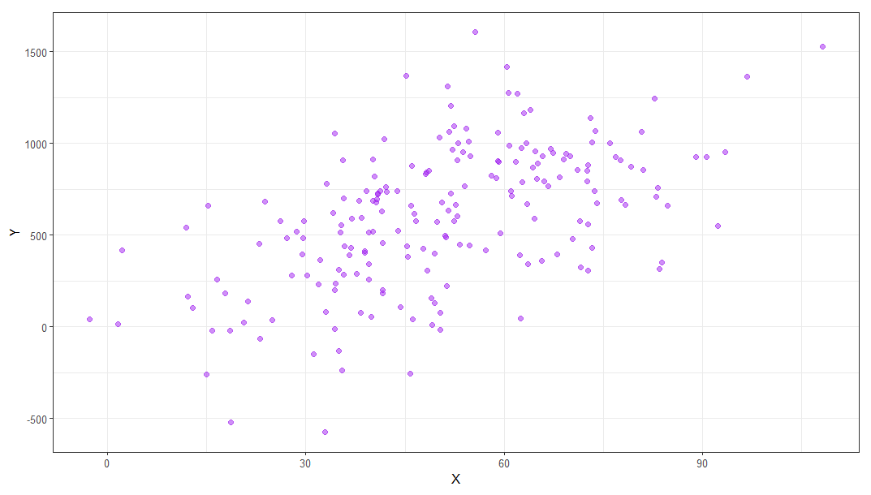
Reactivity process
INPUT
Move the slider to pick a new number
Computer accepts the input from the UI, server function creates the output, and sends output to the UI
OUTPUT
Plot changes

Slide 29
additional output?
Input objects have to be nested within a render function
Manipulations to the input only persist within the render function
What to do if you want to use ‘dat’ for other types of output?
Use a reactive object!

Slide 30
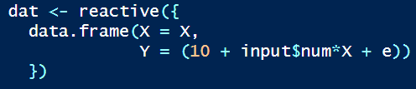
Reactive object
Take the data manipulation out of the renderPlot(), and put it into a separate function
The reactive function creates a reactive object
You call reactive objects like a function
They retain their most recent values, until the input changes or app is stopped

Slide 31
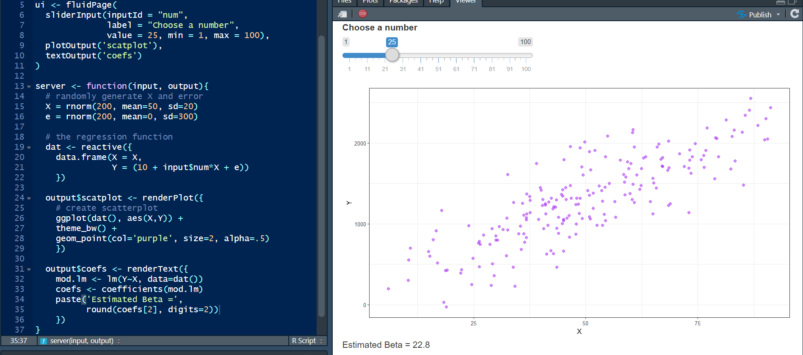
Using Reactive Object to add output
Reactive Object
Call like a function

Slide 32
Using Reactive Object to add output
For New Output
For New Output
New Output

Slide 33
Action buttons

Slide 34
Reactivity and Action buttons
Slider input was instantly reactive
Not all input objects work so instantly
Action buttons can be used to
Generate output on button click
Delay other input from generating output until a button is clicked
Choose a type of action
Server Function* | What It Does When Used With Action Buttons
observeEvent() | Triggers code to run on server after a click and produces output
reactiveEvent() | Creates reactive object after click
*There are many more options. See: https://shiny.rstudio.com/articles/action-buttons.html

Slide 35
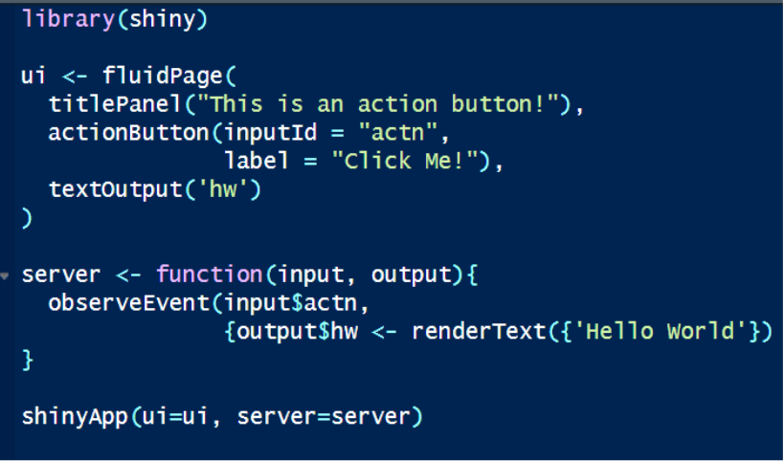
Trigger with Observe event
actionButton() syntax similar to other input objects
For observeEvent()
Inside the parentheses, you put the triggering input object
Input$actn is the trigger
Inside the curly braces, you have the output that is produced after the click
Displaying ‘Hello World’ is the response

Slide 36
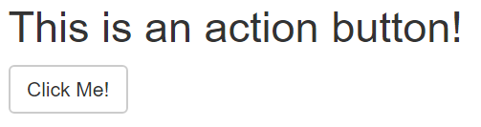
Generates output on button click
Before Click
After Click

Slide 37
Trigger with event reactive
sliderInput() is usually instantly reactive
eventReactive() makes the server function ignore the slider input until the button is clicked
Then the rnums reactive object and output objects are created

Slide 38
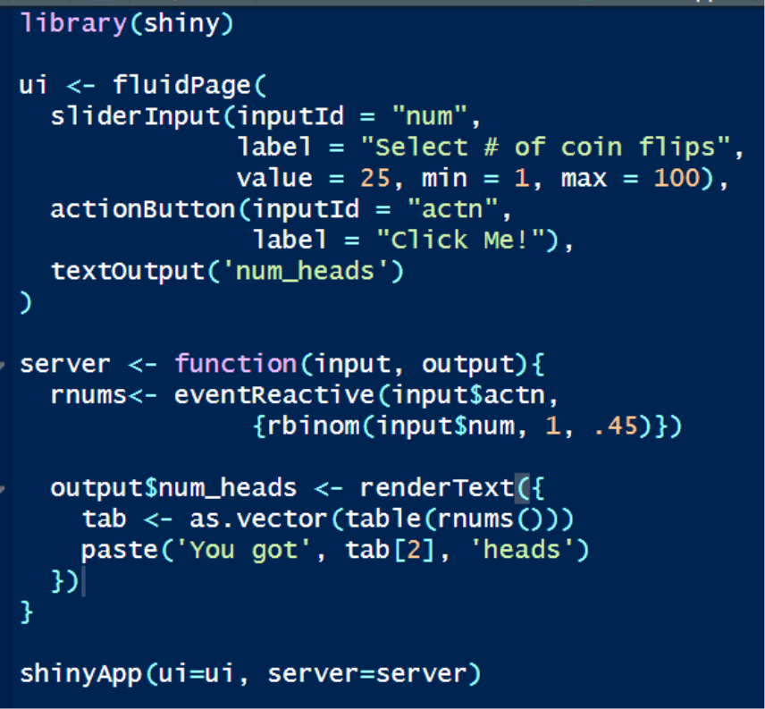
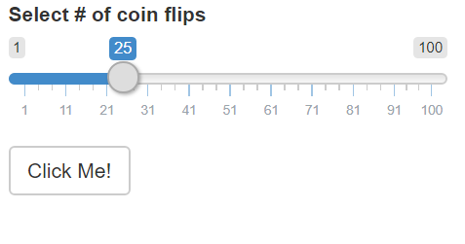
Delays output until button click
Before Click
After Click

Slide 39
Choose a type of action
reactiveValues() creates a reactive list based on an initial set of random binomial values
Paired with observeEvent() we can update the list conditional on button clicks
Two action buttons are used to update
One mimics results from a fair coin
The other has an lower probability of ‘heads’
reactive() vs reactiveValues():
reactive() creates an object
reactiveValues() creates a list

Slide 40
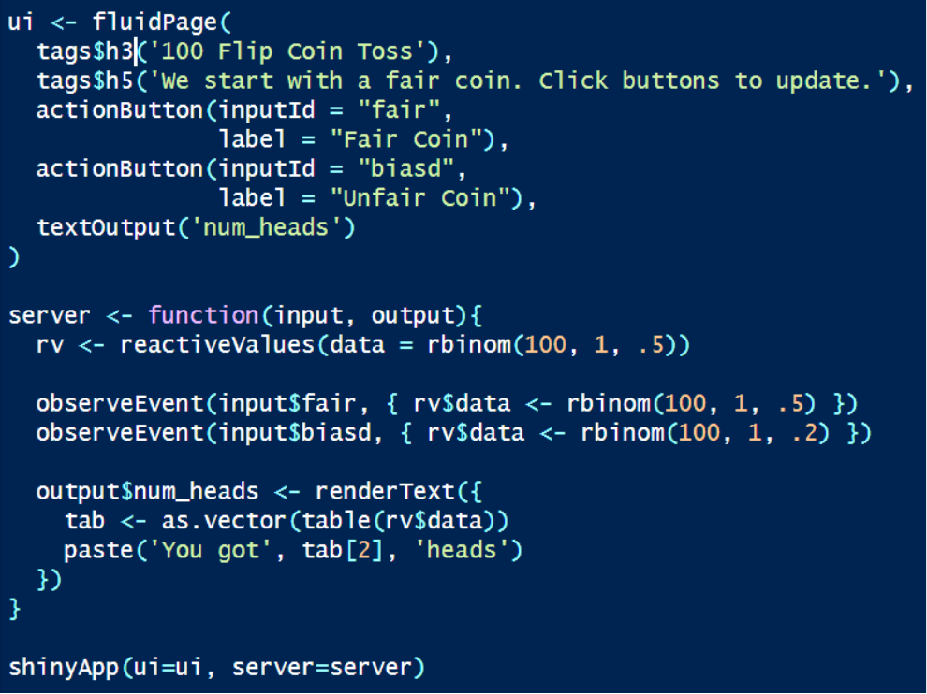
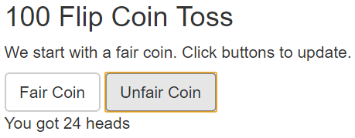
Update values based on choice of action
Before Choice
After Choice

Slide 41
Making apps pretty

Slide 42
Its all about the html/css
Shiny makes web apps
The UI functions are creating HTML and javascript to display and allow interaction
Other HTML language elements are available as functions
HTML uses tags
Shiny uses tag functions
Raw HTML can also be used, though it can be finicky
CSS Stylesheets can be used to customize the look of the app

Slide 43
Common tag functions
Tag Functions | What They Do
a() | A Hyperlink
br() | A line break
code() | Text formatted like computer code
em() | Italicized (emphasized) text
h1(),h2(),h3(),h4(),h5(),h6() | Headers (First level to sixth)
hr() | A horizontal rule (line)
img() | An image
p() | A new paragraph
strong() | Bold (strong) text

Slide 44
Using raw html
You can just include raw HTML
It has to be in quotes and nested within a HTML function
It doesn’t always work
For example, I could not embed a static background image using the HTML tag
fluidPage(
HTML(
‘<h1>This is a header</h1>
<p> Here is a paragraph of text. </p>’
)
)

Slide 45
shinythemes
The shinythemes package provides lots of pre-created themes you can use to make your app look more interesting
Within fluidPage(), type: theme = shinytheme(‘<theme_name>')

Slide 46
Row/column Format functions
Functions enable arranging input and output objects on the page
fluidRow() creates rows content can be put in
Column() will divide the space into columns
Offset allows overlapping columns
Just insert the input or output object into the format function

Slide 47
Panel format functions
These are also nested within fluidPage and allow organizing content on the page
Like row/column functions, insert content within the function

Slide 48
Sharing apps

Slide 49
Host them at shinyapps.io
RStudio runs this
Free if you aren’t using it much
You have to sign up for an account

Slide 50
Makes it easy to monitor apps & share
My Shiny dashboard
All your apps are listed
Each has its own web address and can be shared

Slide 51
Uploading app to Shinyapps.io
Use the rsconnect package
This requires some initial set up to link RStudio to shinyapps.io
You will need info from your shinyapps.io account
After the connection is established, you click on the blue eyeball looking icon

Slide 52
Being your own host
Shiny also provides free software for hosting Shiny apps
This requires a Linux server
See: www.rstudio.com/products/shiny/shiny-server/

Slide 53
For More information
Go to the RShiny site
View the tutorials
Watch some youtube videos
The 3 part ‘How to Start with Shiny’ tutorial by Garrett Grolemund is a great place to start

